Slide 1
Modern Programming Languages
UIIT PMAS Arid Agriculture University, Rawalpindi
Course Instructor: Suleman Khurram

Slide 2
What we will learn in this lecture…
Conditions
If
If-else
Ternary operator
switch
Loops
For loop
While loop
Do-while loop

Slide 3
Flow of Control
Unless specified otherwise, the order of statement execution through a method is linear: one statement after another in sequence
Some programming statements allow us to:
decide whether or not to execute a particular statement
execute a statement over and over, repetitively
These decisions are based on boolean expressions (or conditions) that evaluate to true or false
The order of statement execution is called the flow of control

Slide 4
Conditional Statements
A conditional statement lets us choose which statement will be executed next
Therefore they are sometimes called selection statements
Conditional statements give us the power to make basic decisions
The Java conditional statements are the:
if statement
if-else statement
switch statement

Slide 5
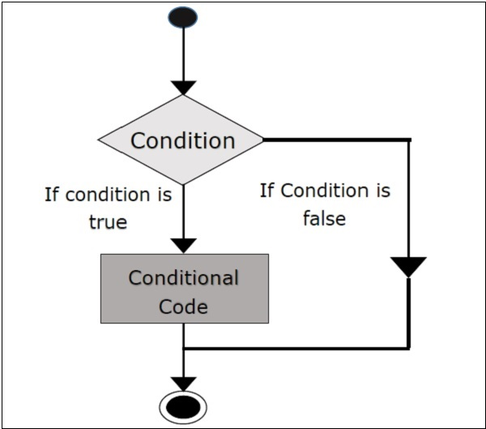
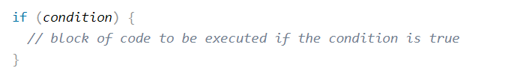
The if Statement
Use the if statement to specify a block of Java code to be executed if a condition is true.

Slide 6
Boolean Expressions
A condition often uses one of Java's equality operators or relational operators, which all return boolean results:
== equal to
!= not equal to
< less than
> greater than
<= less than or equal to
>= greater than or equal to
Note the difference between the equality operator (==) and the assignment operator (=)

Slide 7
The if Statement
An example of an if statement:
First the condition is evaluated -- the value of sum is either greater than the value of MAX, or it is not
If the condition is true, the assignment statement is executed -- if it isn’t, it is skipped.
Either way, the call to println is executed next
if (sum > MAX)
delta = sum - MAX;
System.out.println ("The sum is " + sum);

Slide 8
Indentation
The use of a consistent indentation style makes a program easier to read and understand
"Always code as if the person who ends up maintaining your code will be a violent psychopath who knows where you live."
-- Martin Golding

Slide 9
Logical Operators
Boolean expressions can also use the following logical operators:
! Logical NOT
&& Logical AND
|| Logical OR
They all take boolean operands and produce boolean results
Logical NOT is a unary operator (it operates on one operand)
Logical AND and logical OR are binary operators (each operates on two operands)

Slide 10
Logical NOT
The logical NOT operation is also called logical negation or logical complement
If some boolean condition a is true, then !a is false; if a is false, then !a is true
Logical expressions can be shown using a truth table
a | !a
true | false
false | true

Slide 11
Logical AND and Logical OR
The logical AND expression
a && b
is true if both a and b are true, and false otherwise
The logical OR expression
a || b
is true if a or b or both are true, and false otherwise

Slide 12
Logical Operators
Expressions that use logical operators can form complex conditions
if (total < MAX+5 && !found)
System.out.println ("Processing…");
All logical operators have lower precedence than the relational operators
Logical NOT has higher precedence than logical AND and logical OR

Slide 13
Logical Operators
A truth table shows all possible true-false combinations of the terms
Since && and || each have two operands, there are four possible combinations of conditions a and b
a | b | a && b | a || b
true | true | true | true
true | false | false | true
false | true | false | true
false | false | false | false

Slide 14
Boolean Expressions
Specific expressions can be evaluated using truth tables
total < MAX | found | !found | total < MAX && !found
false | false | true | false
false | true | false | false
true | false | true | true
true | true | false | false

Slide 15
Short-Circuited Operators
The processing of logical AND and logical OR is “short-circuited”
If the left operand is sufficient to determine the result, the right operand is not evaluated
if (count != 0 && total/count > MAX)
System.out.println ("Testing…");
This type of processing must be used carefully

Slide 16
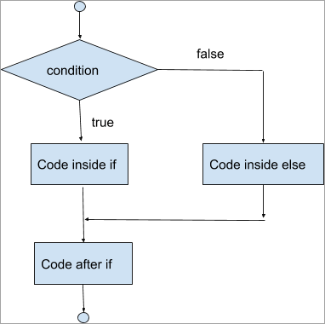
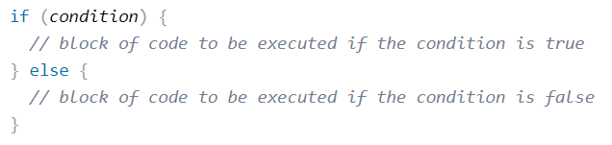
The if-else Statement
Use the else statement to specify a block of code to be executed if the condition is false.

Slide 17
The Conditional Operator (Ternary Operator)
Java has a conditional operator that uses a boolean condition to determine which of two expressions is evaluated
Its syntax is:
condition ? expression1 : expression2
If the condition is true, expression1 is evaluated; if it is false, expression2 is evaluated

Slide 18
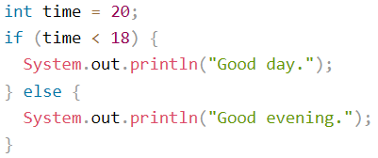

The Conditional Operator (Ternary Operator)
If else:
Ternary Operator:

Slide 19
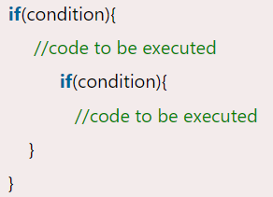
Nested if Statements
The nested if statement represents the if block within another if block. Here, the inner if block condition executes only when outer if block condition is true.

Slide 20
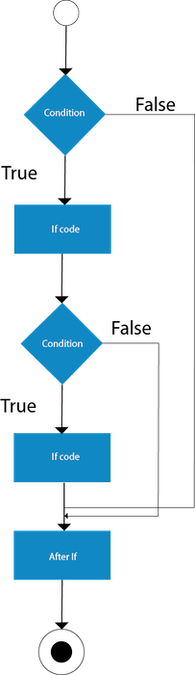

Slide 21
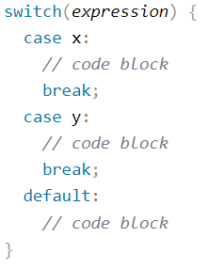
The switch Statement
The switch statement evaluates an expression, then attempts to match the result to one of several possible cases
Each case contains a value and a list of statements
The flow of control transfers to statement associated with the first case value that matches

Slide 22
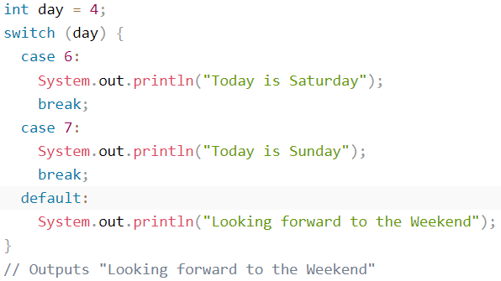
The switch Statement

Slide 23
The switch Statement
A switch statement can have an optional default case
The default case has no associated value and simply uses the reserved word default
If the default case is present, control will transfer to it if no other case value matches
If there is no default case, and no other value matches, control falls through to the statement after the switch

Slide 24
Repetition Statements
Repetition statements allow us to execute a statement multiple times
Often they are referred to as loops
Like conditional statements, they are controlled by boolean expressions
Java has three kinds of repetition statements:
the while loop
the do loop
the for loop
The programmer should choose the right kind of loop for the situation

Slide 25
The while Statement
A while statement has the following syntax:
while ( condition )
statement;
If the condition is true, the statement is executed
Then the condition is evaluated again, and if it is still true, the statement is executed again
The statement is executed repeatedly until the condition becomes false

Slide 26
Logic of a while Loop
condition
evaluated
true
false
statement

Slide 27
The while Statement
An example of a while statement:
int count = 1;
while (count <= 5)
{
System.out.println (count);
count++;
}
If the condition of a while loop is false initially, the statement is never executed
Therefore, the body of a while loop will execute zero or more times

Slide 28
Infinite Loops
The body of a while loop eventually must make the condition false
If not, it is called an infinite loop, which will execute until the user interrupts the program
This is a common logical error
You should always double check the logic of a program to ensure that your loops will terminate normally

Slide 29
Infinite Loops
An example of an infinite loop:
int count = 1;
while (count <= 25)
{
System.out.println (count);
count = count - 1;
}
This loop will continue executing until interrupted (Control-C) or until an underflow error occurs

Slide 30
Nested Loops
Similar to nested if statements, loops can be nested as well
That is, the body of a loop can contain another loop
For each iteration of the outer loop, the inner loop iterates completely

Slide 31
Nested Loops
How many times will the string "Here" be printed?
count1 = 1;
while (count1 <= 10)
{
count2 = 1;
while (count2 <= 20)
{
System.out.println ("Here");
count2++;
}
count1++;
}
10 * 20 = 200

Slide 32
Iterators
An iterator is an object that allows you to process a collection of items one at a time
It lets you step through each item in turn and process it as needed
An iterator object has a hasNext method that returns true if there is at least one more item to process
The next method returns the next item
Iterator objects are defined using the Iterator interface

Slide 33
Iterators
Several classes in the Java standard class library are iterators
The Scanner class is an iterator
the hasNext method returns true if there is more data to be scanned
the next method returns the next scanned token as a string
The Scanner class also has variations on the hasNext method for specific data types (such as hasNextInt)

Slide 34
The do Statement
A do statement has the following syntax:
do
{
statement;
}
while ( condition )
The statement is executed once initially, and then the condition is evaluated
The statement is executed repeatedly until the condition becomes false

Slide 35
Logic of a do Loop
statement
true
condition
evaluated
false

Slide 36
The do Statement
An example of a do loop:
int count = 0;
do
{
count++;
System.out.println (count);
} while (count < 5);
The body of a do loop executes at least once

Slide 37
Comparing while and do
The while Loop
The do Loop
statement
condition
evaluated
true
false
condition
evaluated
true
statement
false

Slide 38
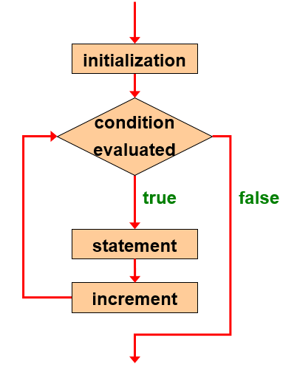

The for Statement
When you know exactly how many times you want to loop through a block of code, use the for loop instead of a while loop:
for (int count=1; count <= 5; count++)
System.out.println (count);

Slide 39
The for Statement
The initialization section can be used to declare a variable
Like a while loop, the condition of a for loop is tested prior to executing the loop body
Therefore, the body of a for loop will execute zero or more times

Slide 40
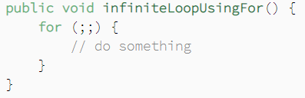
The for Statement
Each expression in the header of a for loop is optional
If the initialization is left out, no initialization is performed
If the condition is left out, it is always considered to be true, and therefore creates an infinite loop
If the increment is left out, no increment operation is performed

Slide 41
Iterators and for Loops
Recall that an iterator is an object that allows you to process each item in a collection
A variant of the for loop simplifies the repetitive processing the items
For example, if BookList is an iterator that manages Book objects, the following loop will print each book:
The iterator version of the for loop is sometimes referred to as the foreach loop
for (Book myBook : BookList)
System.out.println (myBook);

Slide 42
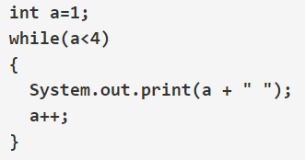
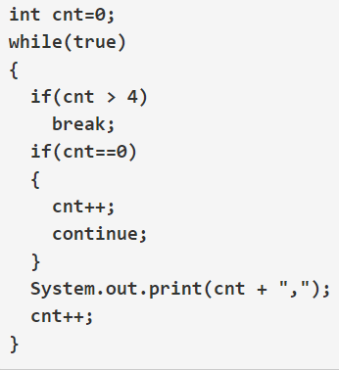
Practice problem
What wil be the output?
Notes:
1 2 3
1,2,3,4

Slide 43
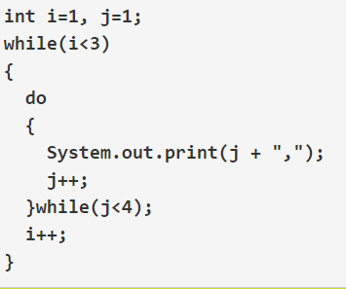
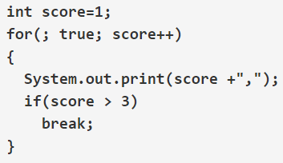
Practice problem
What wil be the output?
Notes:
1,2,3,4,
1,2,3,4,

Slide 44
Practice problem
Write a program to print Fibonacci series of n terms where n is input by user : 0 1 1 2 3 5 8 13 24 .....

